Slide 1
Paper Sculpture
Paper sculpture can be made using any type of paper and any glue
You will be creating a three-dimensional RELIEF sculpture out of paper
The subject matter of your sculpture is entirely up to you, but you should choose a design direction:
  Representational: represents something or somebody
  Abstraction: breaking down subject matter into basic and/or geometric shapes
  Expression: distorting forms and/or color to express personal feelings

Slide 2
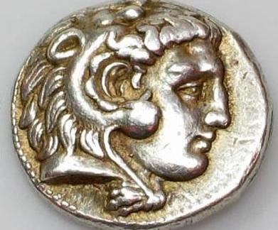
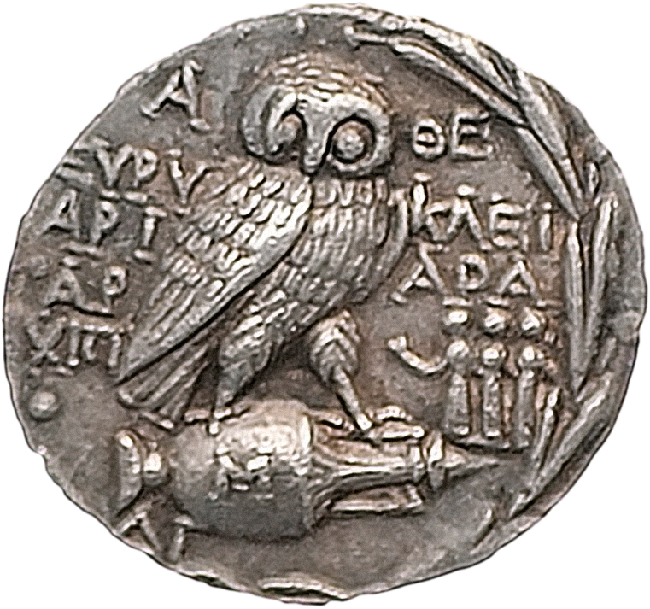
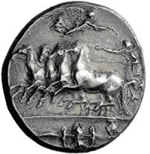
Early Relief Sculpture

Slide 3
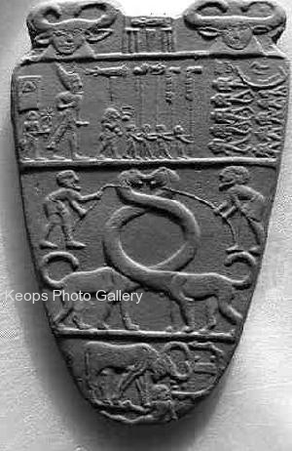
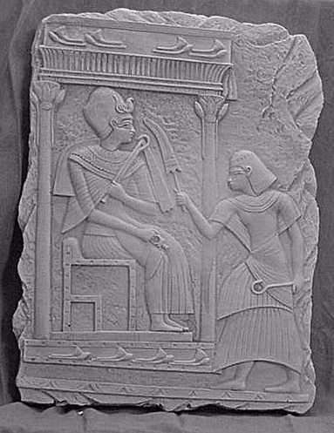

Slide 4
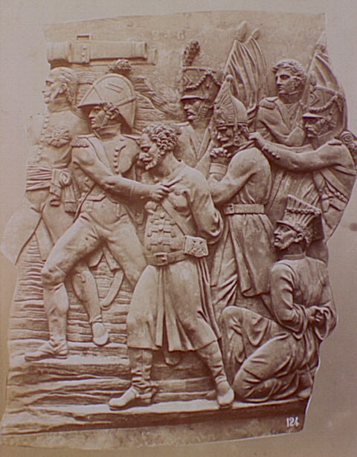

Slide 5
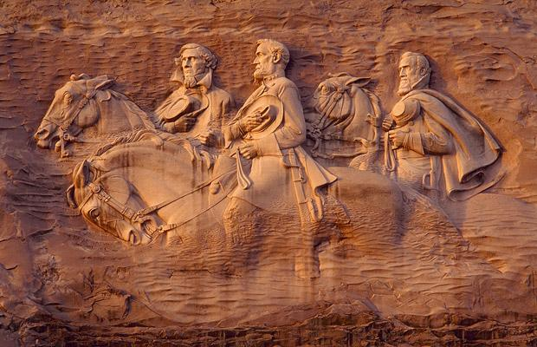

Slide 6
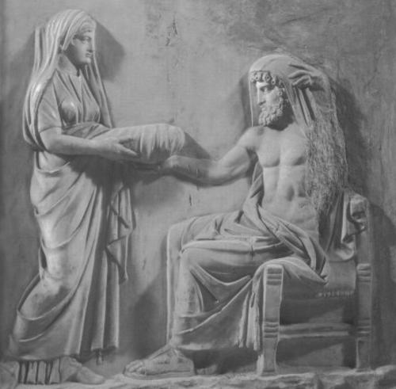

Slide 7
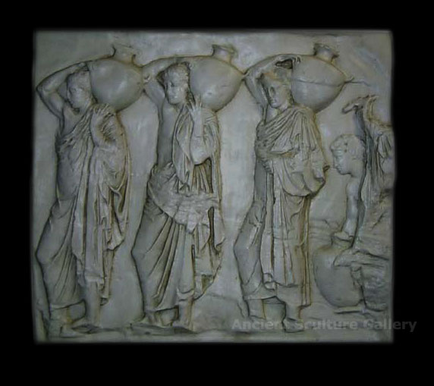

Slide 8
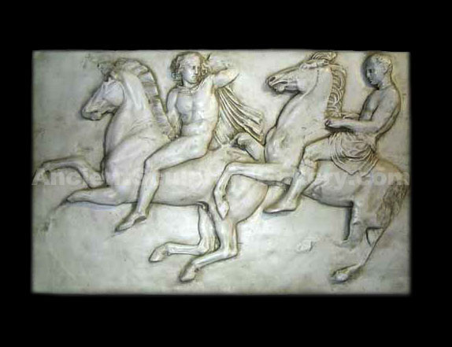

Slide 9
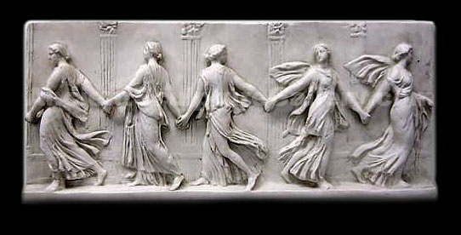

Slide 10
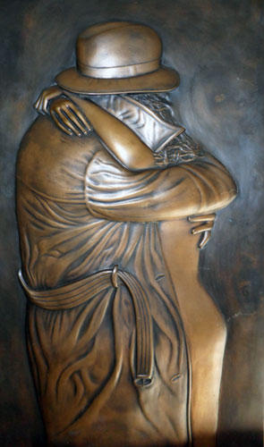

Slide 11
Techniques:
Paper mache
Tissue paper
Curling
Folding/Bending
Build up
  Paper
  Foam core
  Cardboard
Layering
  Foreground, middle ground, background
Low relief, medium relief, high relief

Slide 12
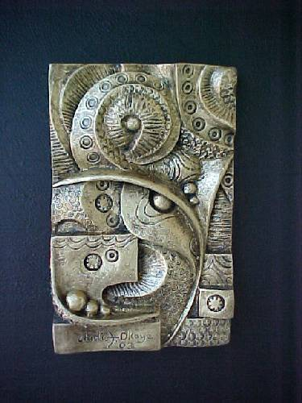

Slide 13
Relief Sculpture
A relief sculpture is a sculpture that is partially carved into or out of another surface.
  These sculptures rely on a base or plane to support them and are a combination of both three dimensional and two dimensional art forms.
This type of sculpture was very popular along the walls and stone columns of the ancient Greek and Roman buildings and can still be seen today on many of famous buildings, including the Coliseum.
Relief sculpture is practiced today by artists and architects.
Relief sculptures were done with stone, marble, bronze and many other substances.
  You will be creating a paper relief sculpture

Slide 14
There are three main types of relief sculptures
  alto (high)
  bas (low)
  and sunken
We will be looking for you to do a combination of high and low relief in your sculptures
  This will be accomplished by building up areas through layering parts on top of one another

Slide 15
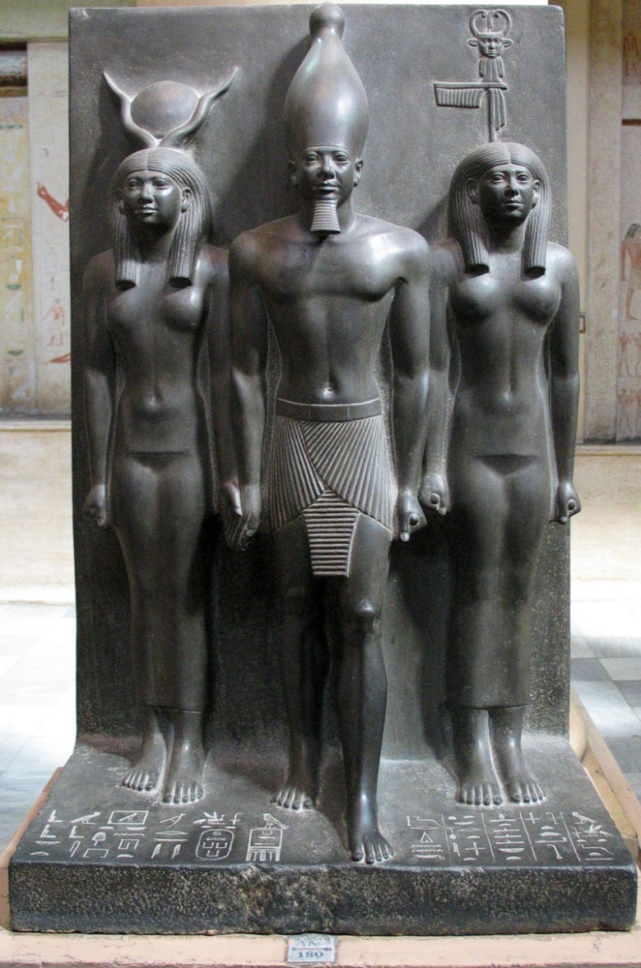
An alto form is almost completely carved from its surface.
Highly shaped, with very little of the structure touching the base or plane.
  It could possibly stand alone if the base or plane were
removed.
Egyptians commonly used alto-relief sculptures of gods or Pharaohs attached to their temples.
Alto reliefs were also common among Greeks and Romans.

Slide 16
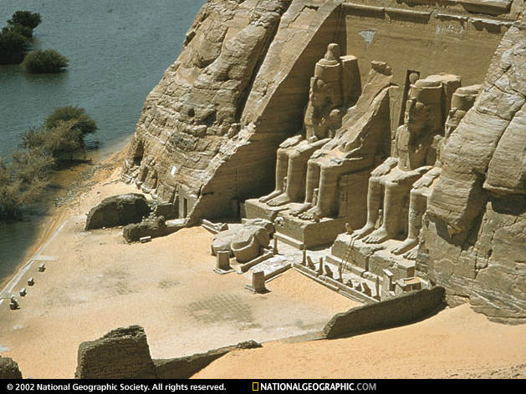
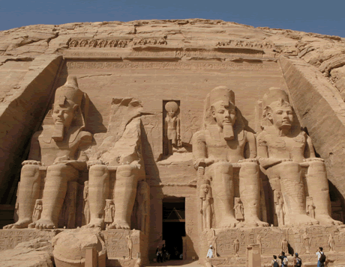

Slide 17
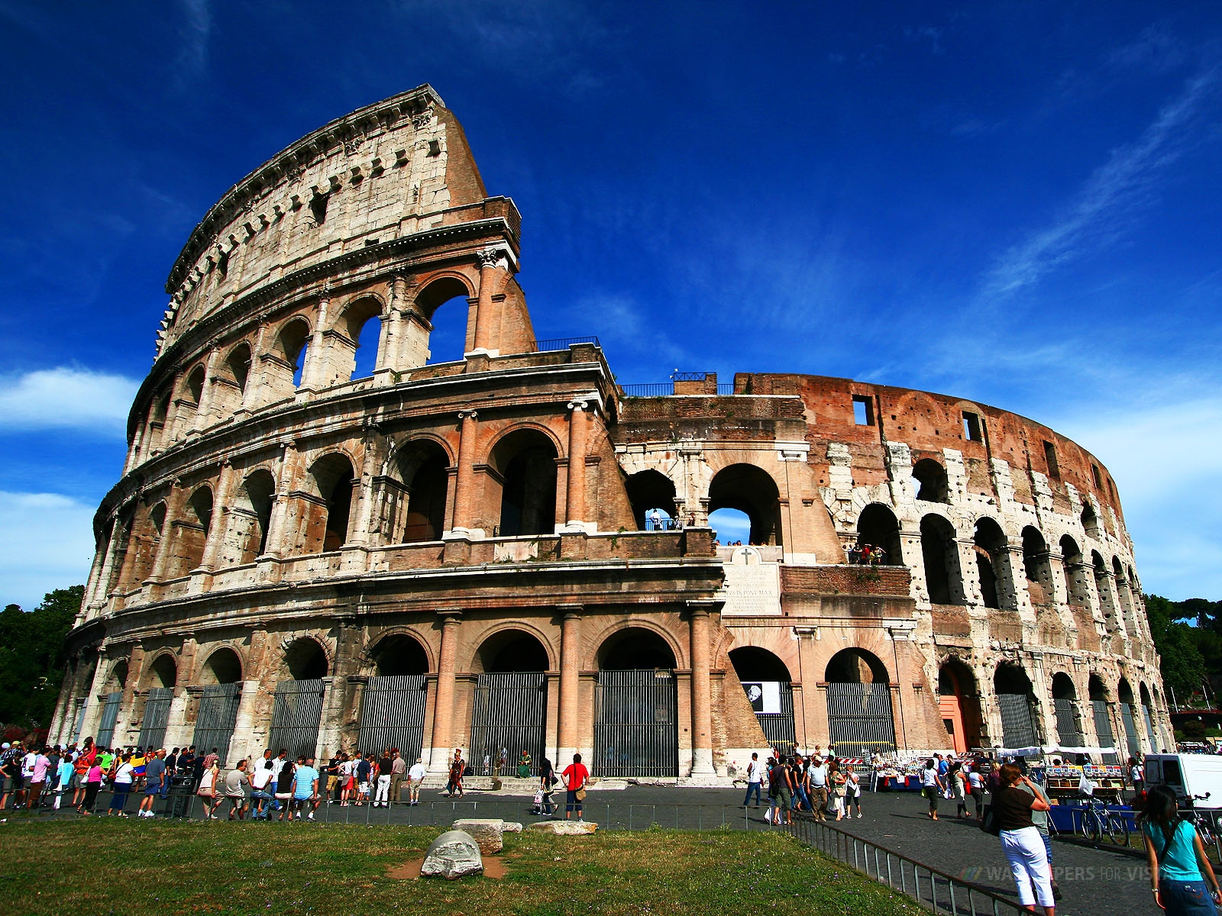
A bas form is a relief that barely extends past the base. These are common as wall decorations on Greek or Roman buildings and are the type mostly seen on the Coliseum.

Slide 18
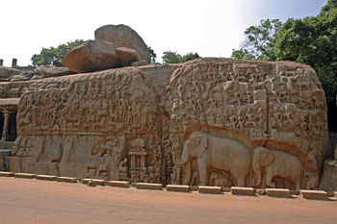
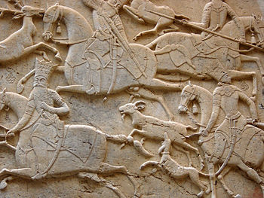
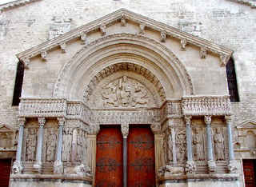
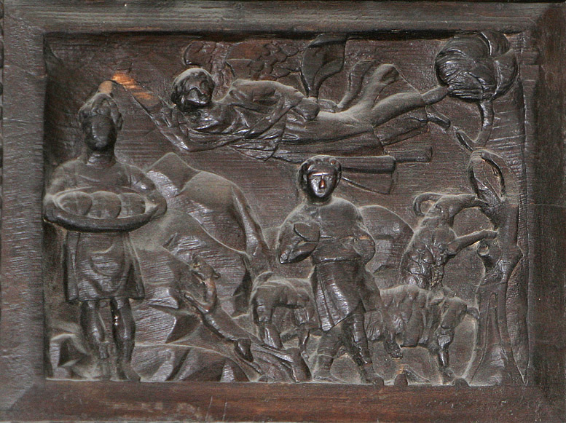
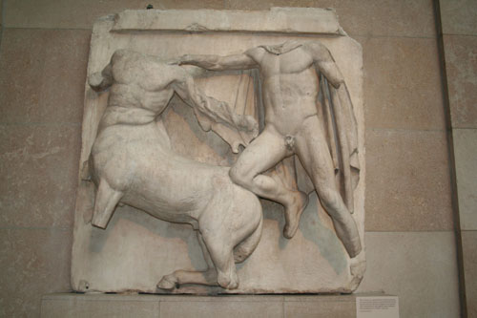

Slide 19
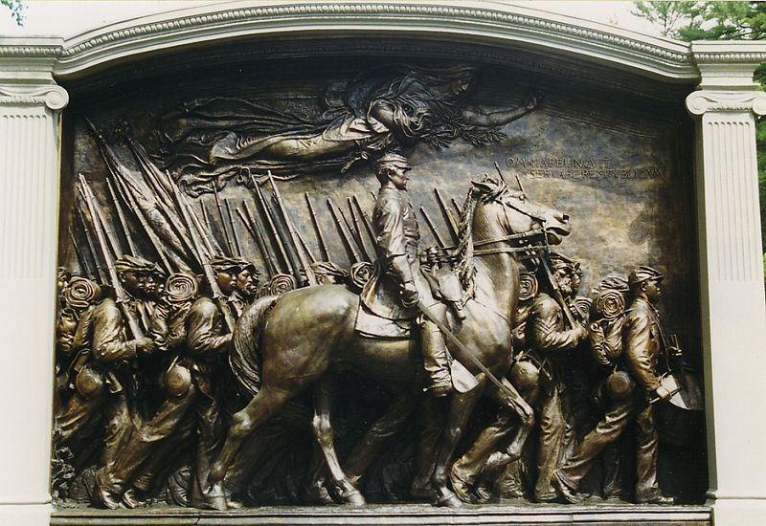

Slide 20
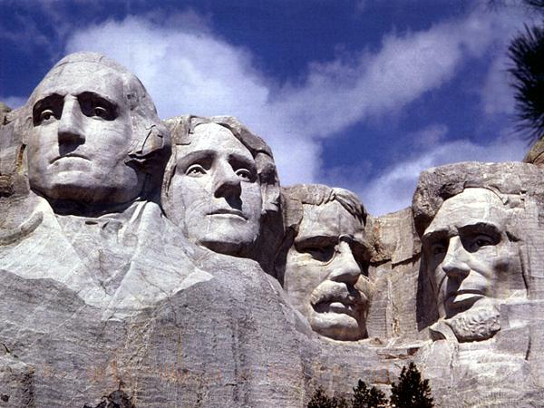

Slide 21
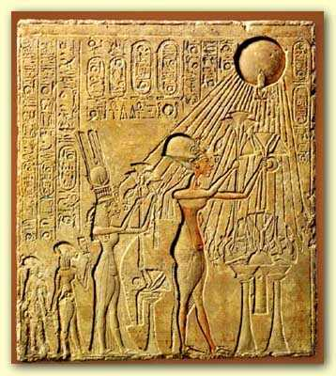
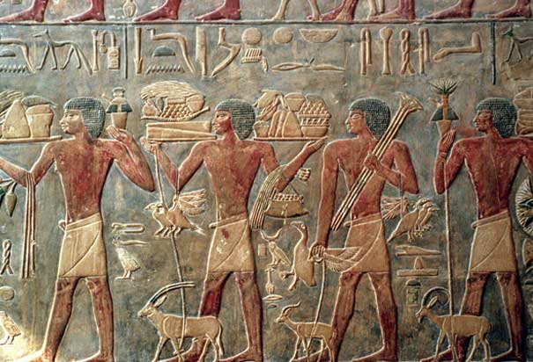
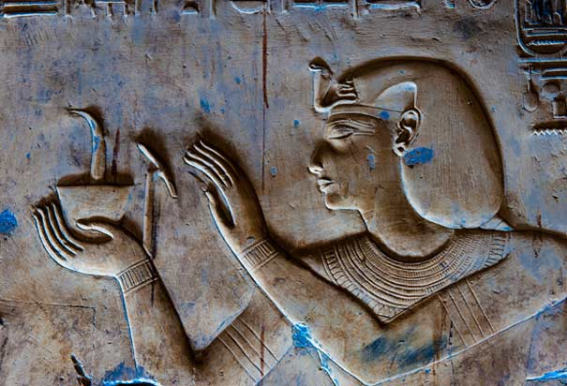
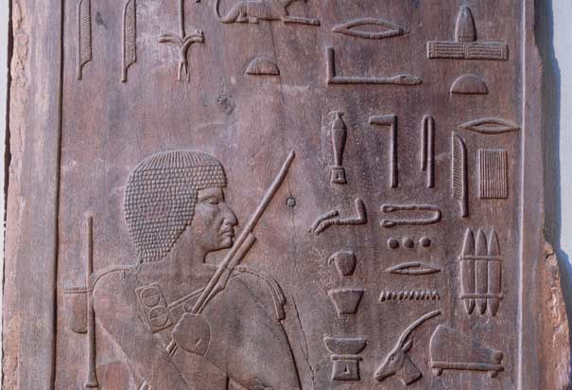

Slide 22
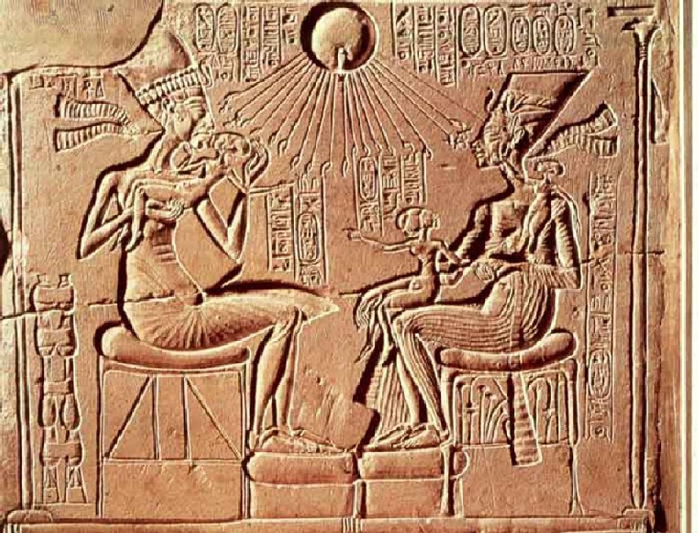
A sunken-relief sculpture is an image that is carved into the surface, rather than out of it

Slide 23
Representational Examples:

Slide 24
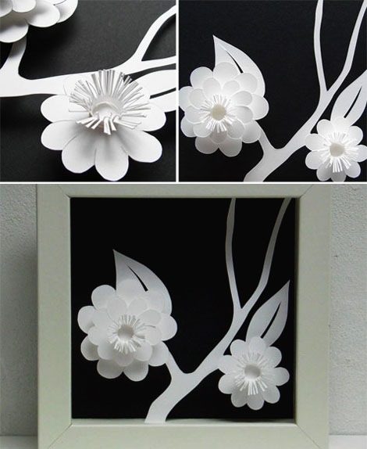

Slide 25
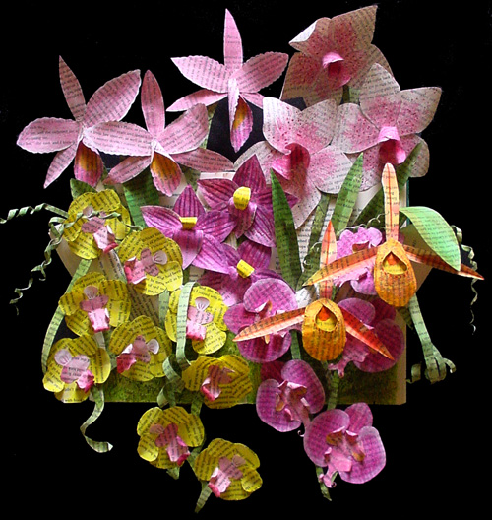

Slide 26
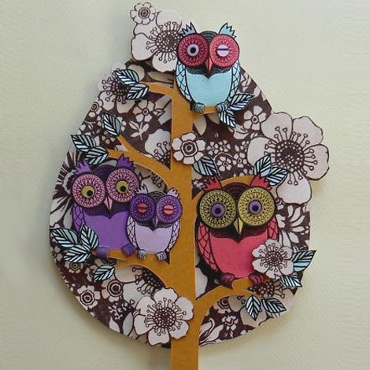

Slide 27
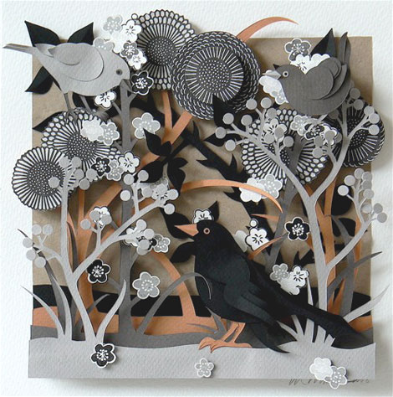

Slide 28
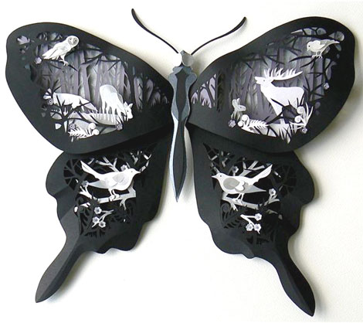

Slide 29
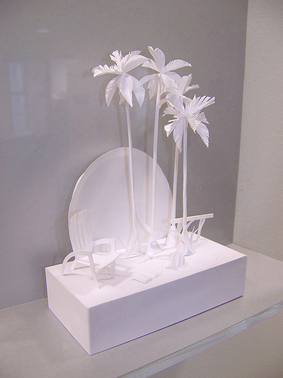

Slide 30
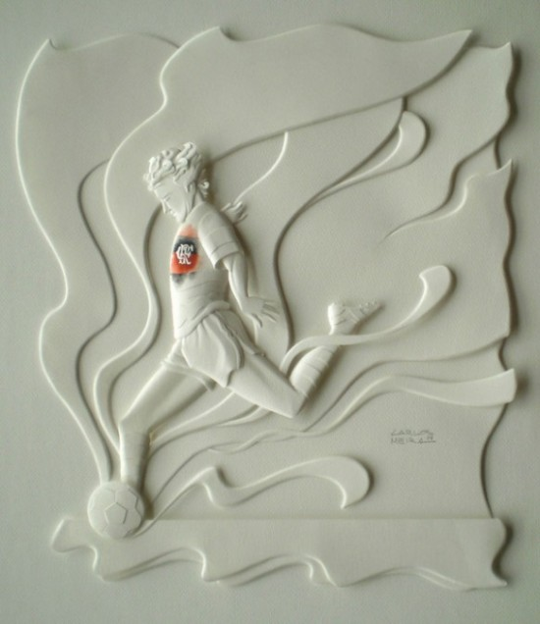

Slide 31
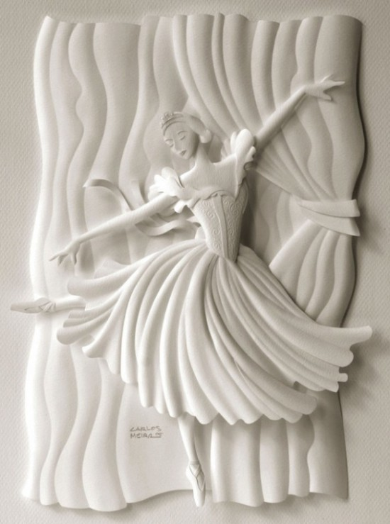

Slide 32
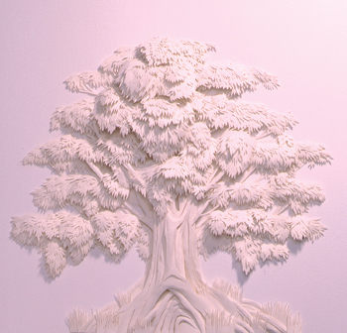

Slide 33
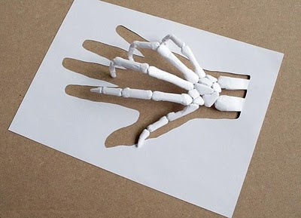

Slide 34
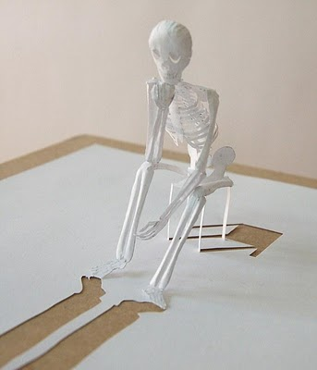

Slide 35
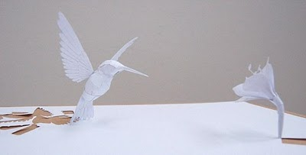

Slide 36
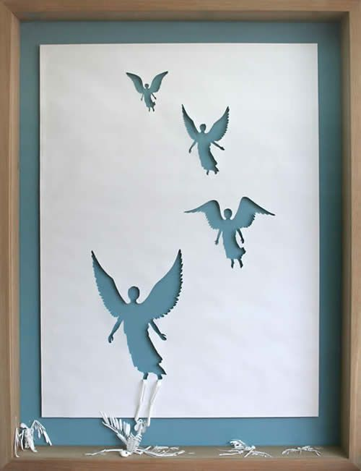

Slide 37
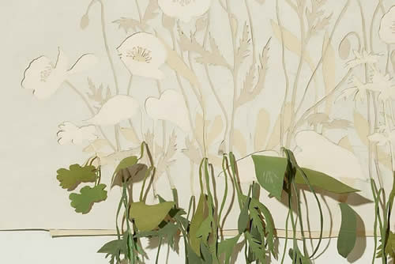

Slide 38
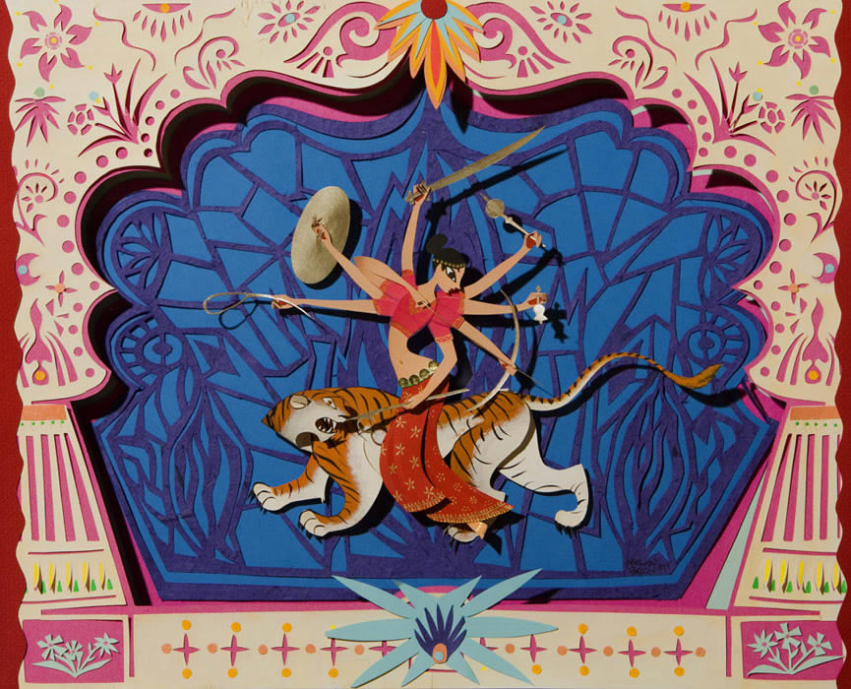

Slide 39
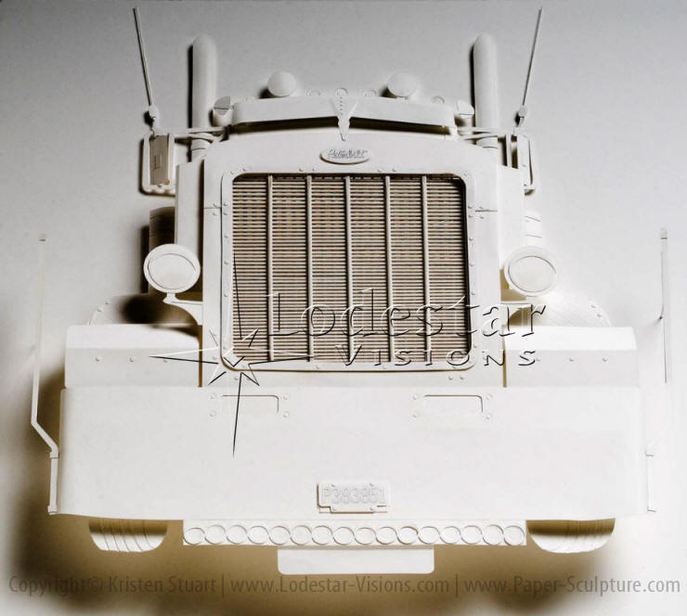

Slide 40
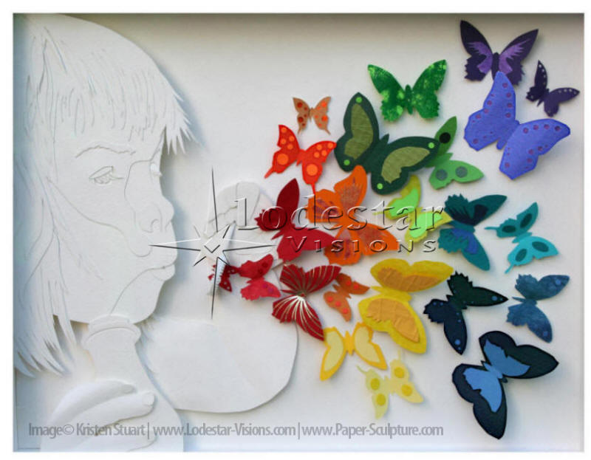

Slide 41
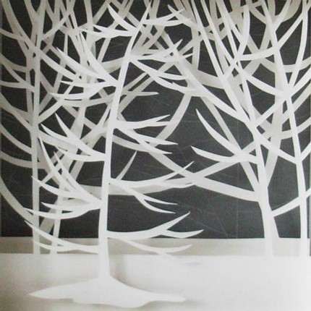

Slide 42
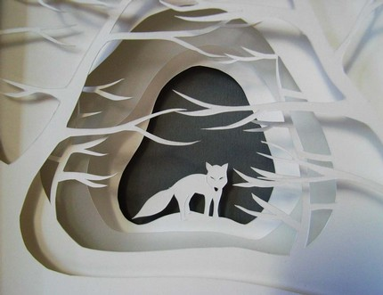

Slide 43
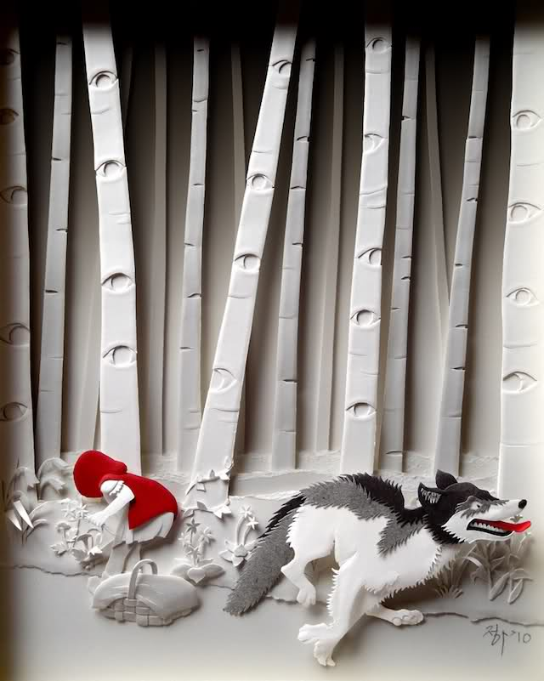

Slide 44
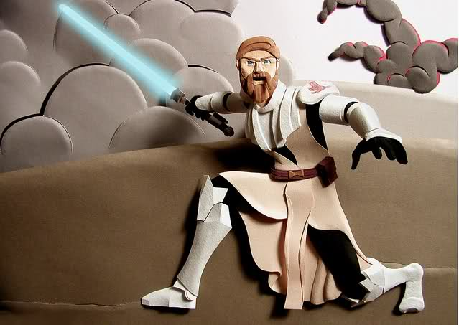

Slide 45


Slide 46


Slide 47


Slide 48


Slide 49


Slide 50


Slide 51


Slide 52


Slide 53


Slide 54


Slide 55


Slide 56


Slide 57


Slide 58


Slide 59


Slide 60


Slide 61
Abstract Examples:

Slide 62


Slide 63



Slide 64


Slide 65


Slide 66


Slide 67


Slide 68


Slide 69


Slide 70


Slide 71


Louise Nevelson

Slide 72



Slide 73


