Slide 1
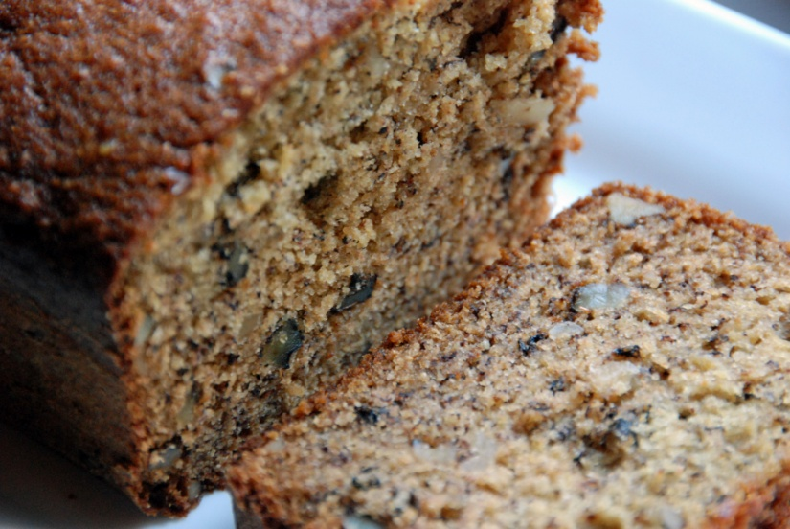
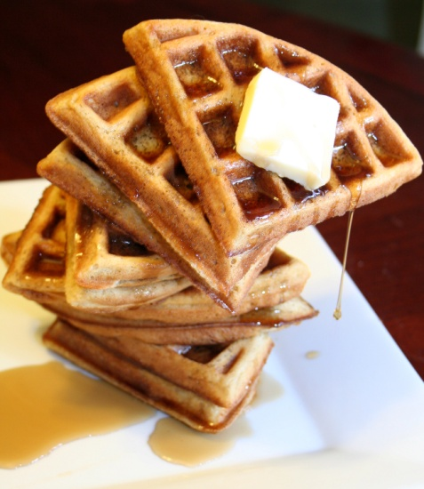
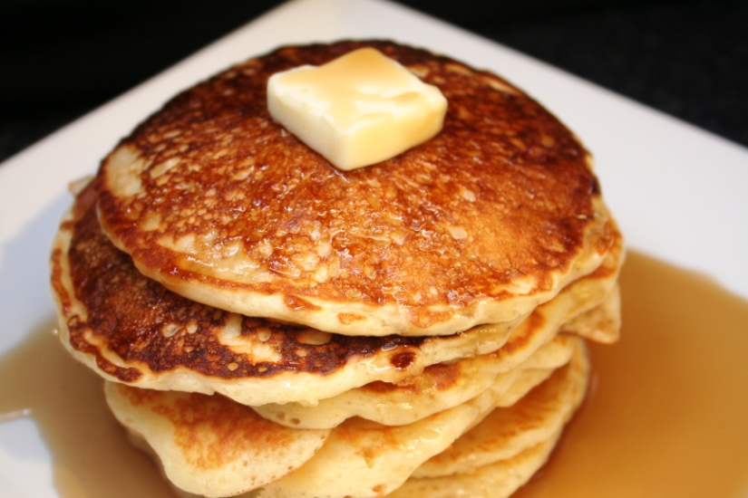
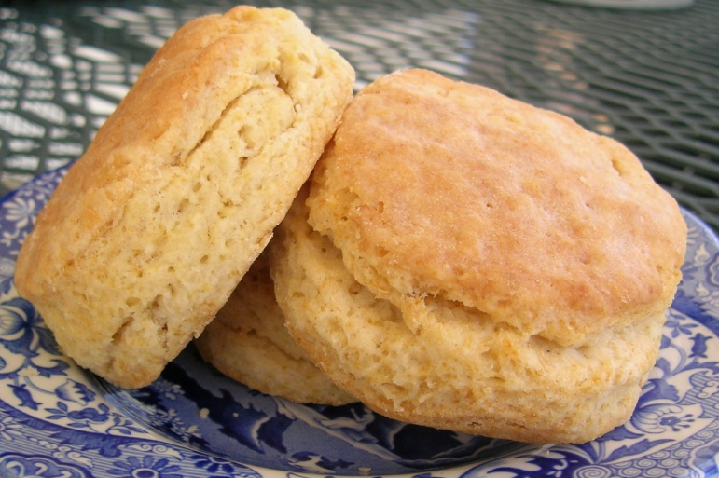
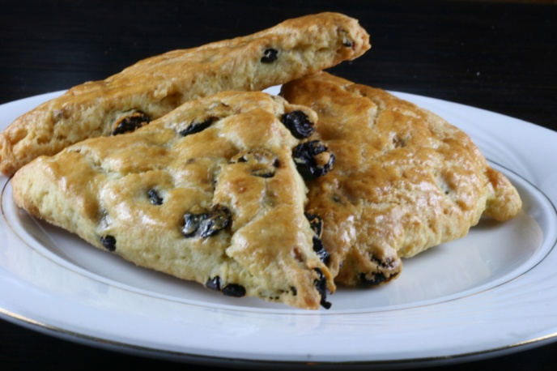
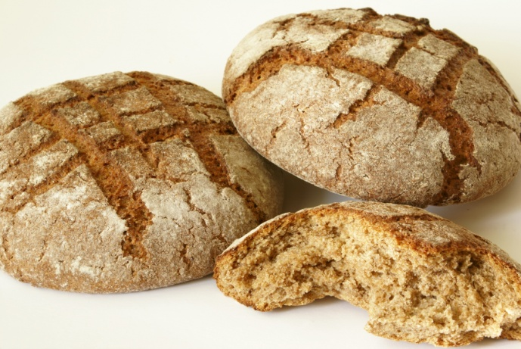
Quick breads
Banana Bread
Waffles
Pancakes
Biscuits
Scones
Soda Bread
No waiting for the dough to rise

Slide 2
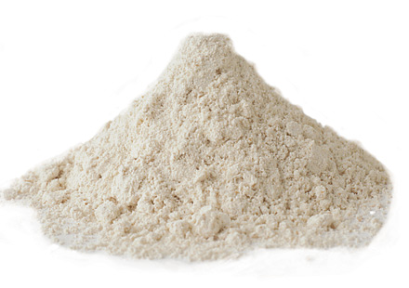
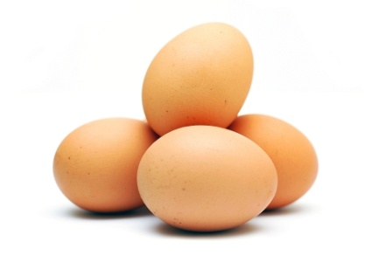
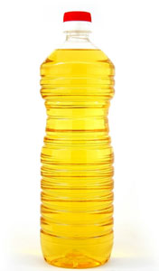
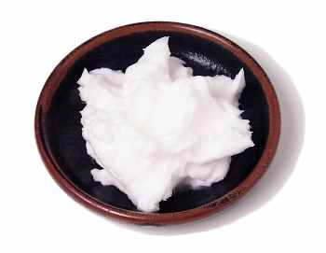
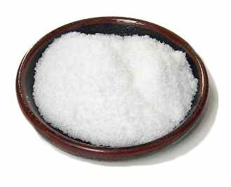
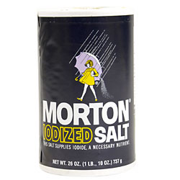
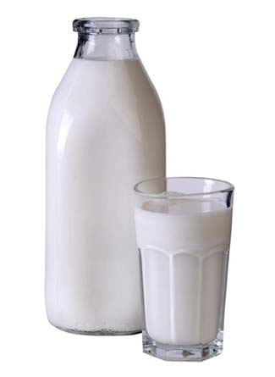
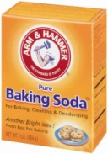
Ingredients In Quick Breads
Flour-hard and soft wheat flours
Eggs-large whole eggs
Fat- usually shortening or oil
Sugar- granulated (confectioners)
Salt- Morton's iodized salt
Leavening Agents- Double acting baking powder baking soda
Liquid- Milk

Slide 3
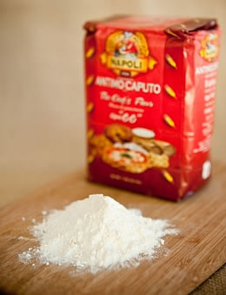
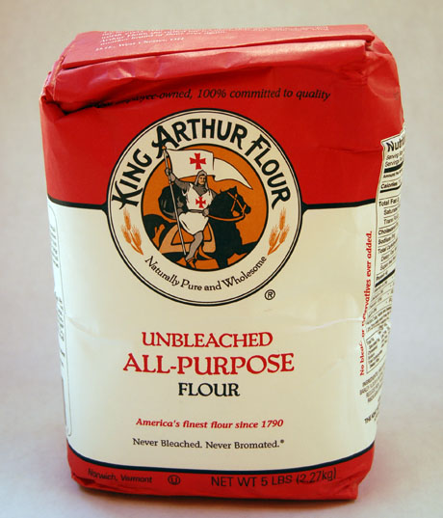
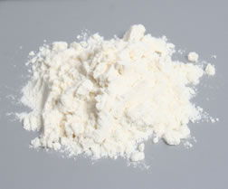
Ingredients in Quick Bread: Flour
Provides structure and a foundation.
A combination of hard and soft wheat flours is best.
Can provide flavor and texture
Other Grains used: Bran, Corn meal, oatmeal
Soft (cake) flour
All Purpose
Hard (bread) flour
+
=

Slide 4
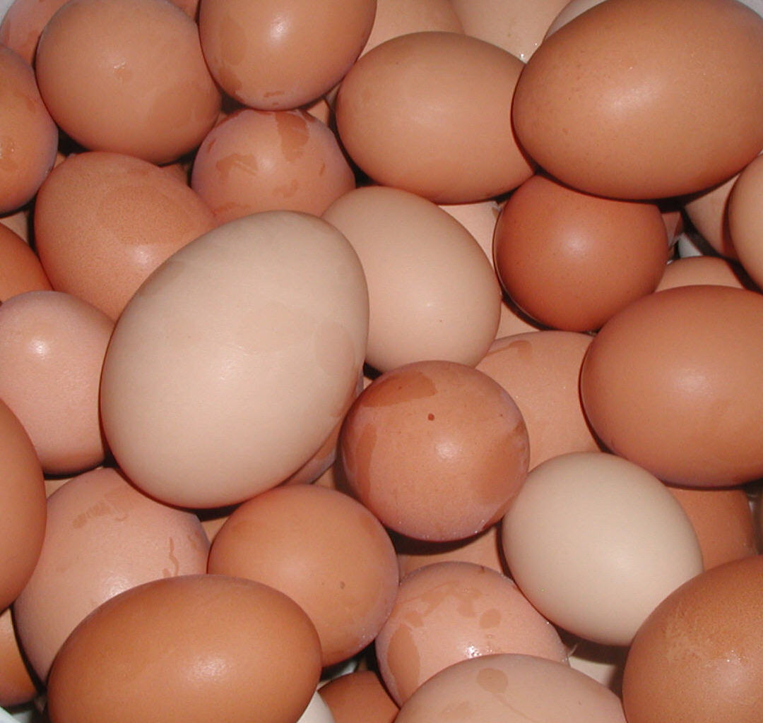
Ingredients in Quick Bread: Eggs
Adds volume
Adds structure.
Provides natural leavening.
Besides texture eggs add Color, Richness, and flavor
Farm fresh large brown whole eggs

Slide 5
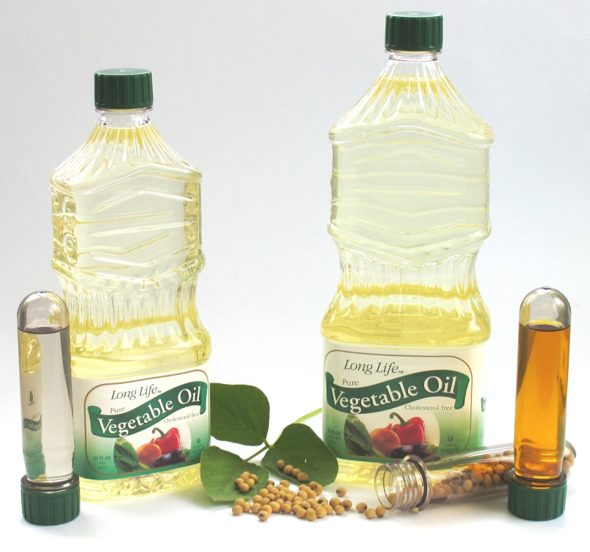
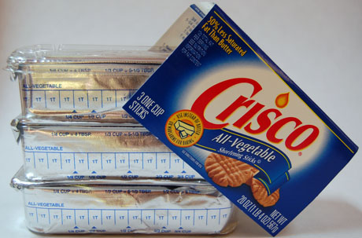
Ingredients in Quick Bread: Fat
Keeps product moist and tender.
It adds in creaming or mixing
All Purpose Shortening
Vegetable Oil

Slide 6
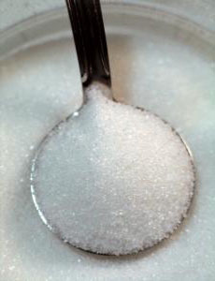
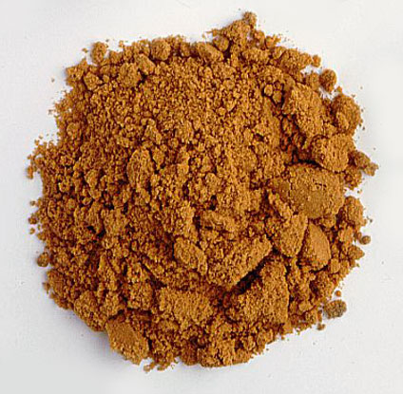
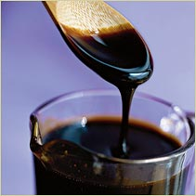
Ingredients in Quick Bread: Sugar
Most of the formulas call for Granulated.
Other sugars include molasses and brown sugar.
Different sugars add sweetness, improve flavor, and adds to color.
Aids in creaming.
Granulated sugar
Brown Sugar
Molasses

Slide 7
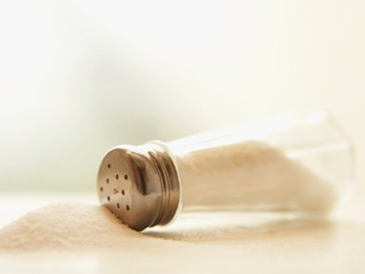
Ingredients in Quick Bread: Salt
Strengthens gluten
Created by mixing flour and a liquid
Adds flavor

Slide 8
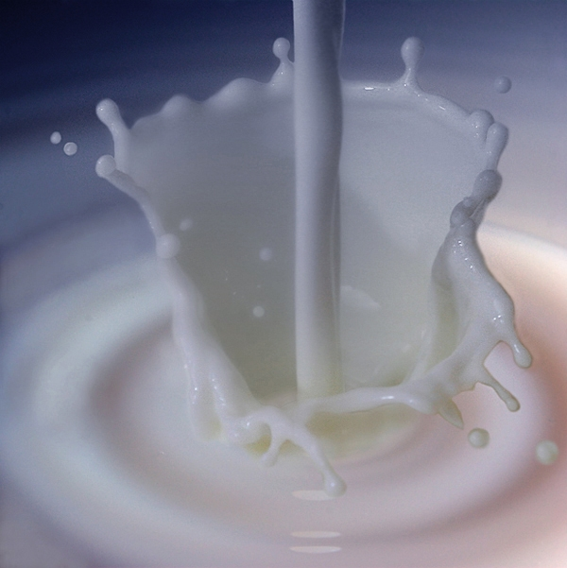
Ingredients in Quick Bread: Liquid
Usually milk
Adds Moisture
Allows dry ingredients to dissolve into liquid. Creating a well blended batter or dough.
Helps create gluten when mixed with flour.

Slide 9
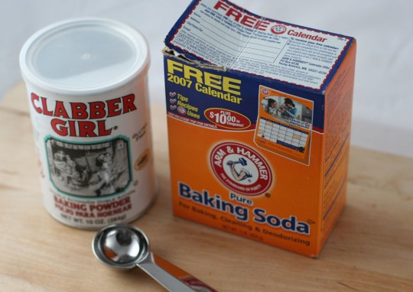
Ingredients in Quick Bread: Leavening Agents
Help leaven or give rise to the quick bread. Creates Carbon Dioxide.
Leavening agents will not work it to much gluten is developed. Overmixing.
Do not use old leavening agents.
Leavening agents lose 10% of their potency each month.
Baking soda needs moisture and an acid to work.
Baking powder has acid in it. Cream of Tatar.
Baking powder and baking soda

Slide 10
Mixing Methods (1 of 3): Biscuit
Cut fat into dry ingredients using a pastry blender.
Then add liquid ingredients.
Knead until dry ingredients are absorbed.
When mixed just enough end product is flaky.

Slide 11
Mixing Methods (2 of 3): Blending (Muffin)
Combine all the liquid, sugar, liquid fat, and eggs at once.
Add dry.
Blending until the dry ingredients are moist
Used in Muffins, loaf breads, fruit bread, pancakes, and waffles.

Slide 12
Mixing Methods (3 of 3): Creaming
Using a paddle on low speed cream together pre-softened shortening and sugar. Light and fluffy.
Add eggs one at a time and flavorings
Alternate adding dry and liquid ingredients.
Makes a cake-like texture.

Slide 13
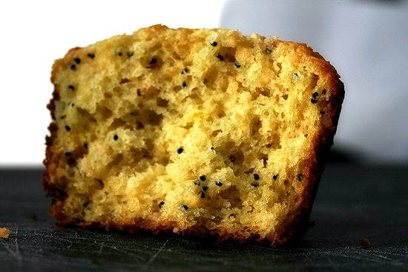
What To Look For In a Quality Muffin
Appearance
Uniform, round, dome top
Color
Golden brown
Texture
Even crumb, tender, moist, NO tunnels
Flavor
Sweet, no bitter after taste

Slide 14
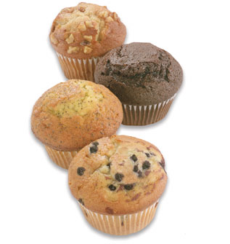
Which quick breads have we prepared?

Slide 15
Types of batters
Pour
Drop
Soft
Firm
Give an example of each…..

Slide 16
Review
Quick Breads- A type of bread made from quick-acting leavening agents, such as baking powder.
Ingredients:
Flour=Structure
Eggs=volume + structure
Fat=tenderizer
Sugar=flavor + color (creaming)
Salt= flavor + strength (gluten)
Leavening agents= rise
Liquid= moisture (gluten)
Three Mixing methods
Quality Muffins
Types of batter

