Slide 1
VEGETABLES

Slide 2
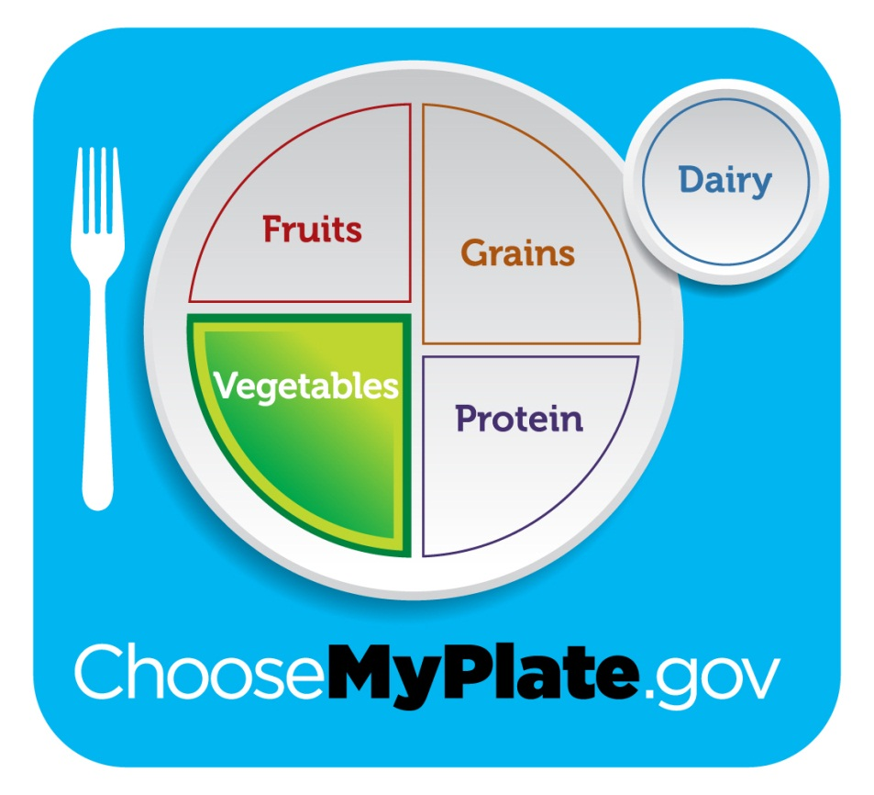
REQUIREMENTS
2 ½ -3 cups
daily
VARY YOUR
VEGETABLES!
food gallery

Slide 3
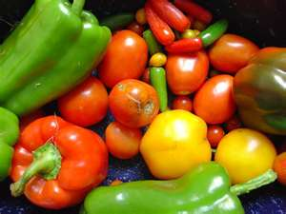
CLASSES OF VEGETABLES
FLOWERS
FRUITS
SEEDS
STEMS
LEAVES
ROOTS
TUBERS
BULBS
FUNGI

Slide 4
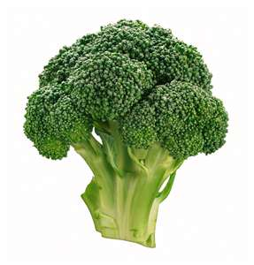
FLOWERS & FRUITS
CAULIFLOWER
BROCCOLI
ARTICHOKE
TOMATOES
CUCUMBERS
PEPPERS
AVACADOS
EGGPLANT
ZUCCHINI
SQUASH

Slide 5
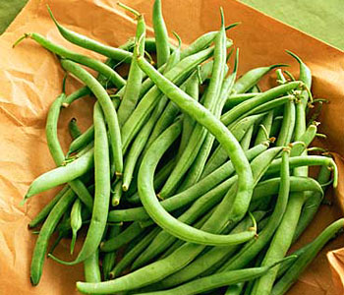
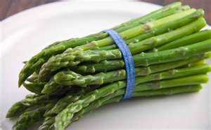
SEEDS & STEMS
BEANS
CORN
PEAS
CELERY
ASPARAGUS

Slide 6
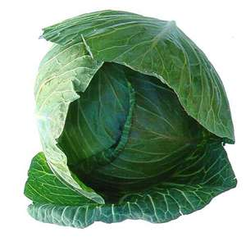
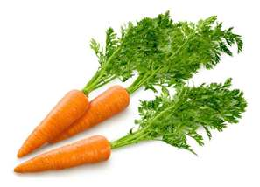
LEAVES & ROOTS
SPINACH
CABBAGE
LETTUCES
CARROTS
TURNIPS
RADISHES
BEETS

Slide 7
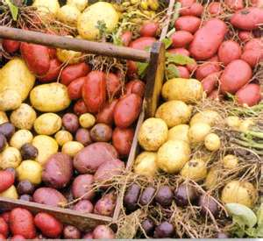
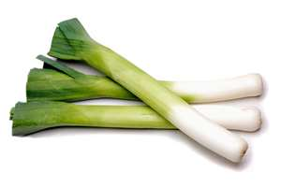
TUBERS & BULBS
POTATOES
YAMS
ONIONS
GARLIC
LEEKS

Slide 8
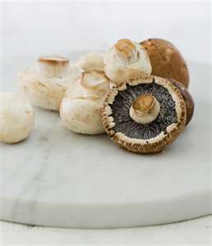
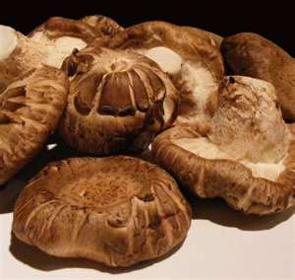
FUNGI (MUSHROOMS)
SHITAKE
PORTOBELLO
WHITE

Slide 9
THINK OF YOR FAVORITE VEGETABLE….
CAN YOU IDENTIFY WHAT CATEGORY IT IS IN?

Slide 10
PREPPING VEGETABLES
ALWAYS WASH AND REMOVE SURFACE DIRT WITH A BRUSH IF AVAILABLE
PEEL SKINS THAT ARE INEDIBLE AND RINSE
REMOVE DAMAGED OR BRUISED AREAS
CONSIDER EATING THE SKIN FOR ADDED NUTRIENTS

Slide 11
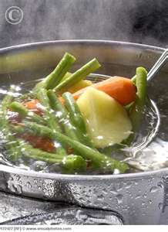
COOKING VEGETABLES
SIMMER
STEAM
BRAISING
FRYING-SAUTE
BAKING
ROASTING
GRILLING
MICROWAVE

Slide 12
ACTIVITY
WITH THE VEGETABLE YOUR GROUP HAS….
THINK OF A METHOD TO PREPARE IT THAT YOU WOULD BE INTERESTED IN EATING
LIST THE INGREDIENTS AND APPROXIMATE COOKING TIME
(KEEP IN MIND FAT CONTENT AS WELL)

Slide 13
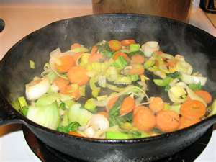
COOKING CHANGES
NUTRIENTS- DISSOLVE/LOSS
TEXTURE-BECOME MORE TENDER
COLOR-CAN BRIGHTEN
FLAVOR-RELEASE AROMA
WHAT ARE SOME AFFECTS OF OVERCOOKING?

Slide 14
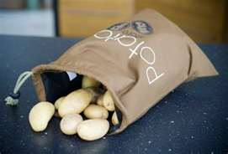
STORAGE
COOL DRY PLACE
AVOID REFRIGERATING TOMATOES, ONIONS, & POTATOES

Slide 15
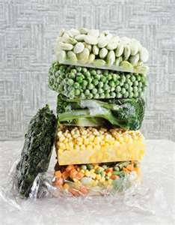
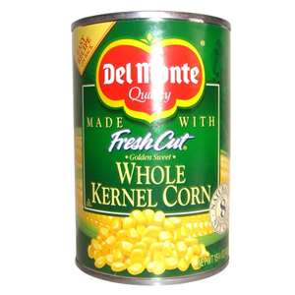
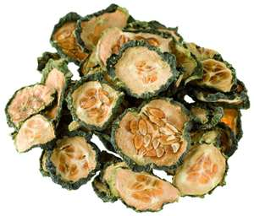
TYPES
FRESH
CANNED
FROZEN
DRIED

Slide 16
WHAT IF I HATE VEGETABLES?
VEGETABLES TASTY?

Slide 17
NUTRITIONAL BENEFITS
VITAMIN A & C
FIBER
LOW IN CHOLESTEROL
LOW FAT
CALCIUM
ANTIOXIDANTS
LOWERS RISK OF CANCER
LOWERS RISK OF HEART DISEASE
CONTROLS BLOOD PRESSURE
STRENGTHENS BONES
PRESERVES VISION

Slide 18
THE REALITY
WHAT MAY BE SOME KEY WAYS TO EATING MORE VEGETABLES?
(THAT WOULD BE REALISTIC FOR YOU)
CAN WE COMBINE THEM WITH SOMETHING WE ENJOY?
JAMIE OLIVER

