Slide 1
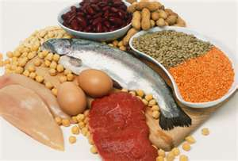
PROTEINS
“FIRST IMPORTANCE”
BUILDING BLOCKS OF LIFE
IT’S 45% OF OUR BODIES!

Slide 2
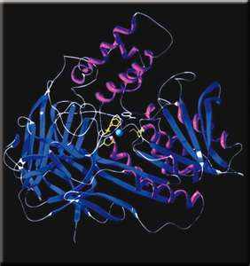
DEFINITION
PROTEIN IS
“AN OBJECT FORMED BY AMINO ACIDS THAT PERFORM DIFFERENT FUNCTIONS IN THE BODY DETERMINED BY THEIR SHAPE.”

Slide 3
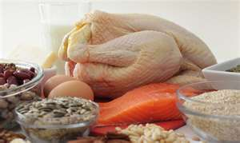
TYPES OF PROTEINS
MEAT-BEEF, PORK, LAMB
POULTRY-CHICKEN, TURKEY
EGGS
BEANS/PEAS-LENTILS, SOYBEANS
NUTS-CASHEWS, PEANUTS, WALNUTS
SEAFOOD-SALMON, SHRIMP, TUNA

Slide 4
FUNCTION
GROWTH & MAINTENANCE
CELL REGROWTH HAIR, SKIN, NAILS
ENZYMES
PROVIDE MEANS FOR CHEMICAL REACTIONS
HORMONES
REGULATE BODY CONDITIONS (METABOLISM, BLOOD SUGAR)
ANTIBODIES
FIGHT DISEASE AND BACTERIA
FLUID BALANCE
ATTRACT WATER AND KEEP FLUIDS CONSTANNE IN THE BLODD
ENERGY
(WHEN CARBS AND FAT) DO NOT PROVIDE IT)
Proteins are, in effect, the main actioners in cells and in an entire organism. Without proteins the most basic functions of life could not be carried out. Respiration, for example, requires muscle contractions, and muscle contractions require proteins.

Slide 5
CHOOSING PROTEINS
SELECT LEAN MEATS
PREPARE MEATS WITH LOW-FAT TECHNIQUES
VARY YOUR CHOICES- BEEF, SEAFOOD, BEANS, ETC.
SUGGESTED TO EAT 8 OZ. SEAFOOD PER WEEK
PREVENTION OF HEART DISEASE
protein foods

Slide 6
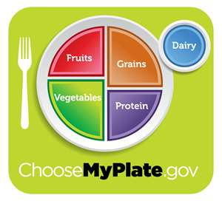
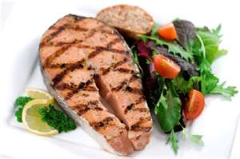
DAILY ALLOWANCE
NEED 5-6OZ. PER DAY.
SERVINGS

Slide 7
REQUIREMENTS
DEPENDENT ON:
AGE
BODY TYPE/SIZE
QUALITY OF PROTEIN
FITNESS LEVEL
REQUIREMENTS
10-30% OF TOTAL CALORIES
PROTEINS ARE BROKEN DOWN INTO AMINO ACIDS WHICH ARE THEN USED TO MAKE CUSTOM PROTEINS
SUPPLEMENTS HAVE NOT SHOWN TO INCREASE MUSCLE

Slide 8
CALCULATING REQUIREMENTS
USE TOTAL CALORIE INTAKE FOR DAY
EXAMPLE: 2,000 CALORIES
MULTIPLY BY 10% AND 30%
200 & 600 THEM DIVIDE BY 4
EQUALS= 50 TO 150 GRAMS ALLOWANCE

Slide 9
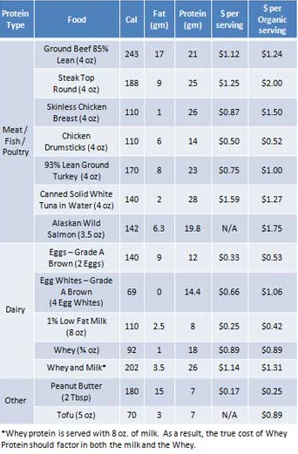

Slide 10
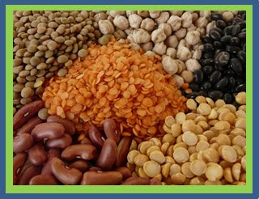
COMPLETE/INCOMPLETE
PLANT VS. ANIMAL
COMPLETE- SUPPLY ALL ESSENTIAL AMINO ACIDS
INCOMPLETE- SOME AMINO ACIDS ARE SUPPLIED (VEGETARIANS)
ONLY THE SOY BEAN IS A
COMPLETE PLANT PROTEIN
PROTEIN COMPARISON

Slide 11
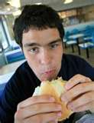
ACTIVITY
COMPOSE A LIST OF PROTEINS THAT YOU ATE YESTERDAY.
DETERMINE WHETHER YOU HAVE MADE THE REQUIREMENTS
WHAT COULD YOU HAVE EATEN DIFFERENTLY TO SATISFY THE REQUIREMENTS?

Slide 12
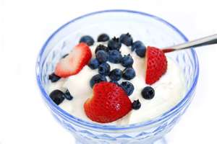
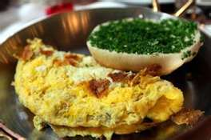
DAILY PROTEINS
CONSUME AT EACH MEAL
ESPECIALLY AT BREAKFAST
NEED FUEL FOR THE DAY, AND TO REPAIR
EXCESS PROTEIN IS STORED AS FAT NOT PROTEIN
CAN SERVE IN PLACE OF FAT/ CARBS

Slide 13
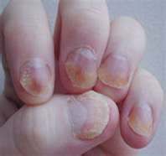
DEFICIENCIES
CAN CAUSE:
FATIGUE
WEIGHT LOSS
LETHARGY
LIMITED GROWTH
BRITTLE HAIR/NAILS
LIVER DAMAGE
LOWER DISEASE RESISTANCE

Slide 14
ACTIVITY
WRITE A DAILY MEAL PLAN OF PROTEINS FOR YOURSELF

