Slide 1
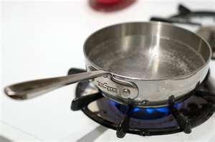
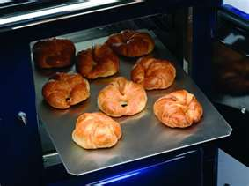
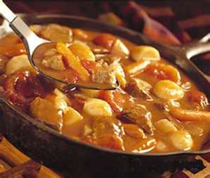
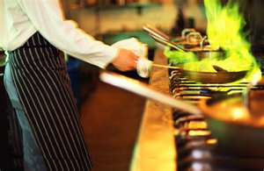
COOKING METHODS
THE BASICS
COOKING IS… THE TRANSFER OF HEAT TO FOOD

Slide 2
HOW FOOD IS COOKED
CONDUCTION
TRANSFER OF HEAT THROUGH A SURFACE
CONVECTION
MOVEMENT OF MOLECULES THROUGH AIR OR LIQUID
RADIATION
HEAT TRANSFER THROUGH ENERGY WAVES

Slide 3
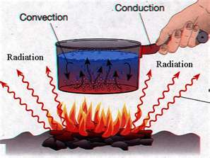
HEAT TRANSFER

Slide 4
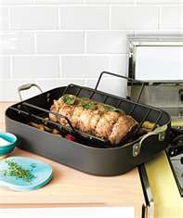
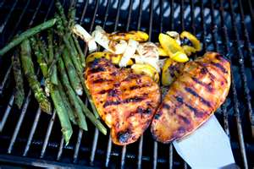
DRY COOKING METHODS COOKING FOOD WITHOUT LIQUID
ROAST
BAKE
BROIL
GRILL

Slide 5
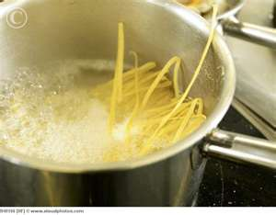
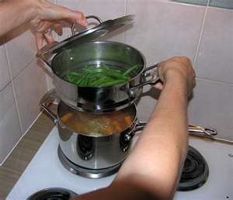
MOIST COOKING METHODS FOOD IS COOKED IN HOT LIQUID
BOILING
SIMMERING
POACHING
STEAMING
PRESSURE-COOKING
BLANCH
BRAISING
STEWING

Slide 6
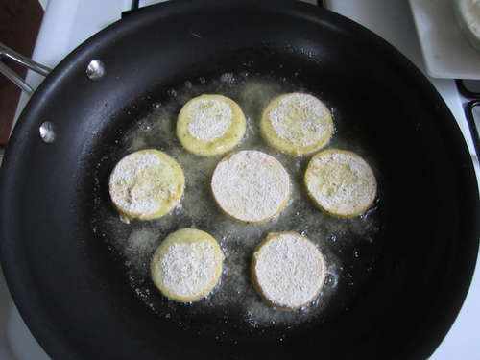
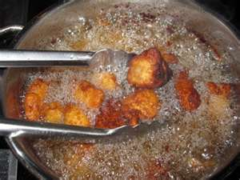
FRYING ALWAYS USES FAT
FRY
SAUTE
PAN BROIL
DEEP FRY
STIR FRY

Slide 7
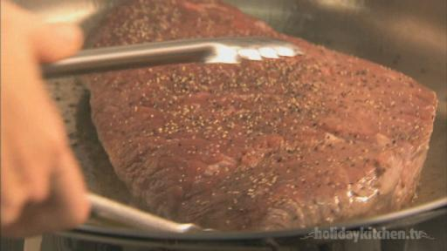
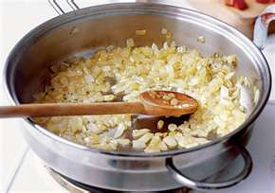
OTHER TERMS
CARMELIZATION
BROWNING OF SUGAR
SEAR
TO BROWN QUICKLY AT A HIGH TEMP
SWEAT
TO COOK UNTIL SOFTENED
WITHOUT BROWNING

Slide 8
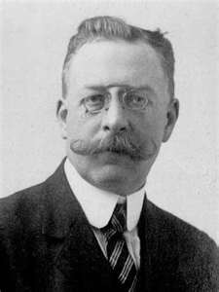
EFFECTS ON FOOD AND NUTRITION
NUTRIENTS ARE TYPICALLY LOST
RELEASE OF FLAVOR
CHANGE IN TEXTURE
CHANGE IN COLOR
CAN DARKEN OR LIGHTEN
MAILLARD REACTION
Maillard demo

Slide 9
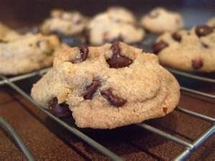
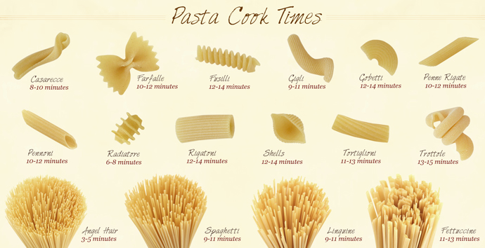
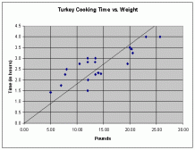
COOKING RATES
DENSITY
SHAPE
SIZE
AMOUNT
TEMPERATURE

Slide 10
METHOD SELECTION
QUALITY OF INGREDIENTS
TIME ALLOTMENT
INTENDED FLAVOR OR TEXTURE
ROLE IN THE DISH –ACCOMPANIMENT, ETC.
RESOURCES- COOKWARE, TOOLS

