Slide 1
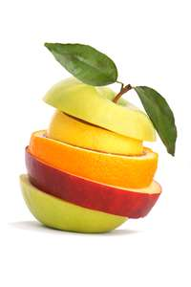
FRUITS
from Old French, frūī to enjoy]
from Latin frūctus enjoyment, profit, fruit,

Slide 2
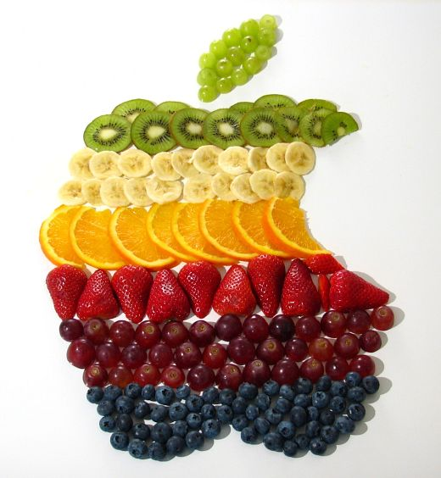
REQUIREMENTS
1 ½ -2 CUPS daily
WHAT DOES THIS EQUATE TO?
WHY WOULD YOU CHOOSE FRESH OVER CANNED OR FROZEN?
CITE 3 REASONS

Slide 3
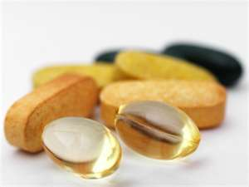
1 OF 5 FOOD GROUPS FRUIT PROVIDES….
BETA CAROTENE-ANTIOXIDANT, PROTECTS SKIN & EYES
VITAMIN C- PROTECTS IMMUNE SYSTEM
CALCIUM-BONE STRENGTH
VITAMIN D- SKIN & BONE HEALTH
FIBER-PREVENTS CONSTIPATION
FOLIC ACID-BRAIN DEVELOPMENT & NERVOUS SYSTEM
MAGNESIUM-HELP BODY CONVERT ENERGY AND BALANCES MINERALS
PREVENTS HEART DISEASE, DIABETES, OBESITY, HIGH BLOOD PRESSURE, CANCERS, HIGH CHOLESTEROL,

Slide 4
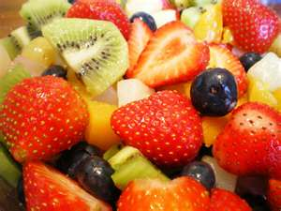
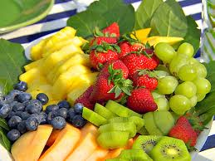
CATEGORIES
CITRUS
BERRIES
EXOTICS
GRAPES
MELONS
POMES
PEARS
DRUPES
TROPICALS

Slide 5
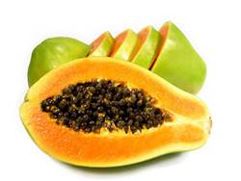
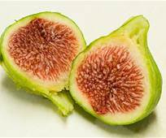
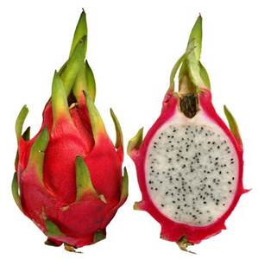
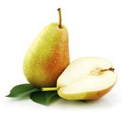
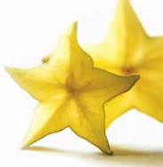
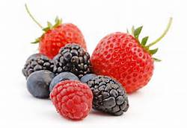
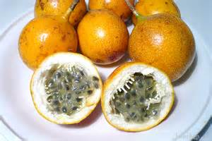
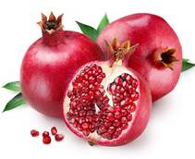
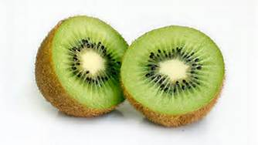
EXAMPLES
CITRUS –LEMONS, LIMES, ORANGES, GRAPEFRUITS
BERRIES-STRAWBERRIES, BLACKBERRIES, RASPBERRIES
EXOTICS-GUAVA, POMEGRANATES, FIGS, DRAGON, PASSION
GRAPES-GLOBE,WHITE
MELONS-CANTALOUPES, HONEYDEW, WATER
POMES-APPLES
PEARS-ASIAN BARLETT
DRUPES-APRICOT, CHERRIES, PEACHES, PLUMS
TROPICALS-KIWIS, PINEAPPLES, MANGOES, PAPAYA, BANANAS, STAR

Slide 6
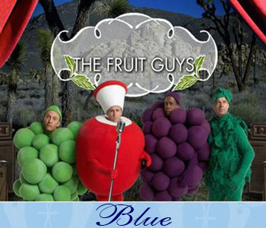
ACTIVITY
MAKE A LIST OF FRUITS THAT YOU EAT REGULARLY
WHICH DO YOU EAT SEASONALLY?
WHICH ONES WOULD YOU LIKE TO TRY?

Slide 7
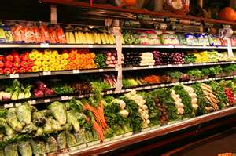
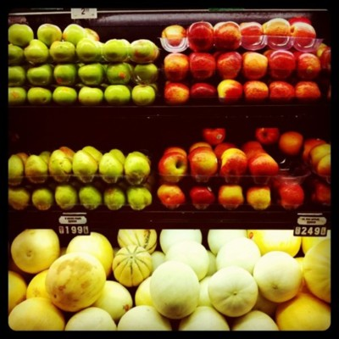
FRUIT SELECTION
CONDITION
DENSENESS
COLOR
AROMA
SIZE
SHAPE
FRUIT SELECTION

Slide 8
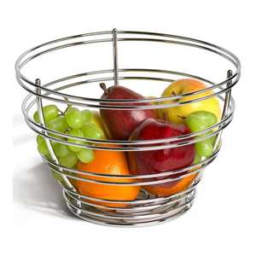
STORAGE
UNDERRIPE
BERRIES/BANANAS
CITRUS
CUT
KEEP IN MIND…
FRUITS STORED CLOSE TO EACH OTHER MAY RIPEN MORE QUICKLY!

Slide 9
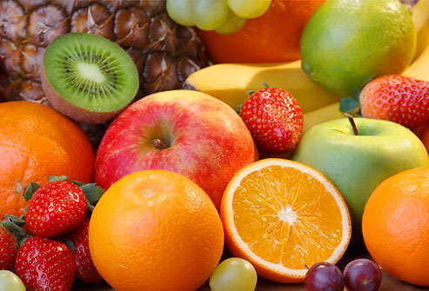
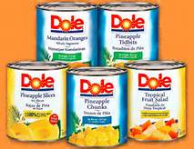
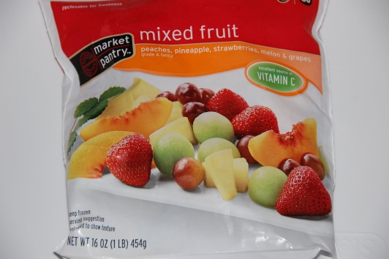
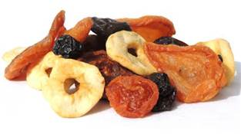
VARIETIES
FRESH
FROZEN
DRIED
CANNED
JUICES
WHY MIGHT YOU CHOOSE ONE OVER ANOTHER?
TOP 10 FRUITS

Slide 10
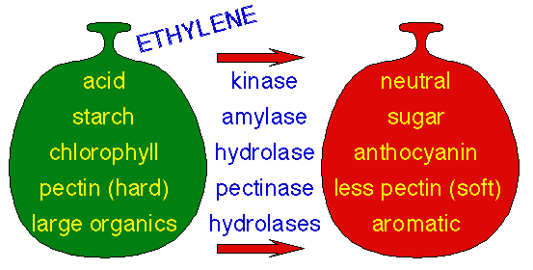
RIPENING
UNDERRIPE- KEEP AT ROOM TEMP.
DARK CLOSET WILL KEEP FRUIT FROM RIPENING LESS THAN IN SUNNY WINDOW.
BROWN BAGS ARE RECOMMENDED FOR FRUITS THAT CAN TRANSFER FLAVOR TO OTHER FRUITS
SOME FRUITS DO NOT RIPEN AFTER BEING-PICKED (APPLES,GRAPES,BERRIES,CITRUS)
FRUIT RIPENING

Slide 11
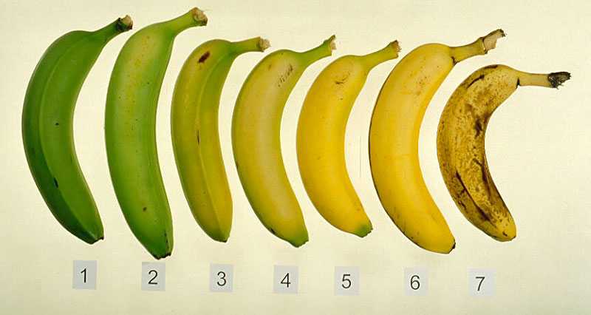
RIPENING

Slide 12
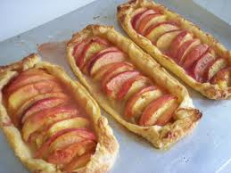
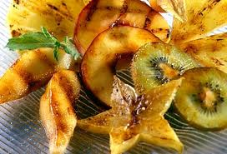
PREPARATION
BROIL
GRILL
BAKE
POACH
SIMMER
FRY
ALWAYS WASH FRUIT WHEN YOU ARE GOING TO EAT IT, DO NOT USE SOAP (IT CAN REACT WITH CHEMICALS ON THE FRUIT’S SKIN)

Slide 13
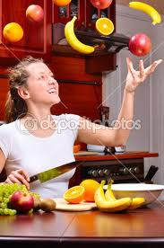
COOKING FRUITS
NUTRIENTS- LOSS OF HEAT SENSITIVE VITAMINS
COLOR-MAY DARKEN OR BECOME LIGHTER
FLAVOR- BECOMES MELLOW
TEXTURE- BECOMES MORE TENDER
SHAPE- CAN FALL APART…NEED SUGAR

Slide 14
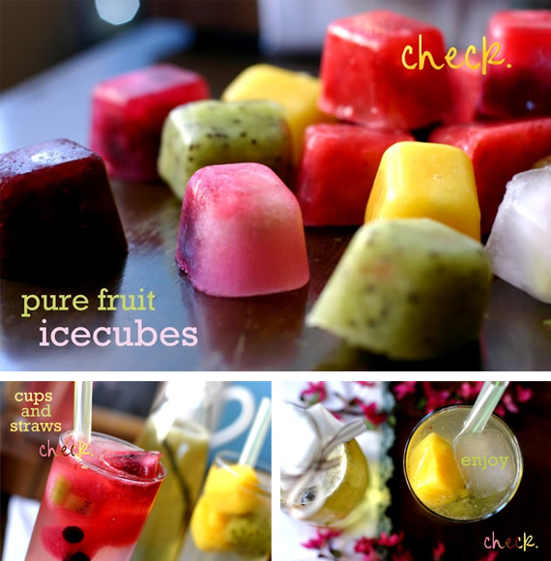
COOL STUFF
http://stories-etc.com/fruit.htm
fruit tips

