Slide 1
Relations Between the West & Middle East Throughout History
By Lily McNamara, Molly Keenan, Julian Donadeo, Maddie Monaco, Matthew Collins, Ilsa Papunen, and Sienna Richert

Slide 2
Historiography
Oriental (non-western) vs. Occidental (western)
(Edward Said)
Western imperialism
Western European imperialist countries took over: Africa, Asia, Latin America
MYTH: “Third world countries are underdeveloped because of infertile lands and unproductive people”

Slide 3
Treasures in the Non-West
The lands of Africa, Asia, and Latin America have produced great foods, treasures, and natural resources
European desire to steal and plunder them
These resources included...
gold, silver, furs, silks, and spices
flax, hemp, timber, molasses, sugar, rum, rubber, tobacco, calico, cocoa, coffee, cotton, copper, coal, palm oil, tin, iron, ivory, ebony
oil, zinc, manganese, mercury, platinum, cobalt, bauxite, aluminum, and uranium
Notes:
http://www.michaelparenti.org/Imperialism101.html

Slide 4
The Rise of Islam
610 CE Muhammad receives his first revelations
Muhammad and his followers move to Yathrib
Around 640 CE Islam spreads to Africa
In the 700s CE Islam reaches Europe
Notes:
http://www.pbs.org/wgbh/pages/frontline/teach/muslims/timeline.html

Slide 5
Conflict due to Islam
The rise of Islam created tension between Christian Europe and the Middle East
Western Christians tried to impose their religion in the Middle East
Notes:
http://www.pbs.org/wgbh/pages/frontline/shows/muslims/themes/west.html

Slide 6
Invasion of the Iberian Peninsula
The invasion began in 711 C.E., with the arrival of a small Muslim army, and after the defeat of the reigning Visigoths the peninsula was almost completely conquered by 720 C.E.
The course of the invasion and occupation took place mostly within the period of Regional and Transregional Interaction (600 C.E.—1450 C.E.)
Spain, known as Al-Andalus under Muslim rule, became a center of technology and education, even during the Middle Ages.
Knowledge from ancient Rome and Greece was preserved.
Notes:
http://lostislamichistory.com/christianity-and-the-muslim-conquest-of-spain/
http://www.hispanicmuslims.com/andalusia/andalusia.html

Slide 7
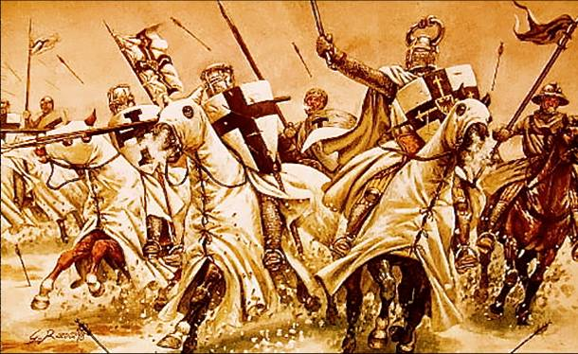
The Crusades
600-1450 Regional and Transregional Interaction
War between Europe and Muslims
Led to defeat for Europeans, but also the Age of Exploration and the Renaissance
Development and interaction of cultures theme

Slide 8
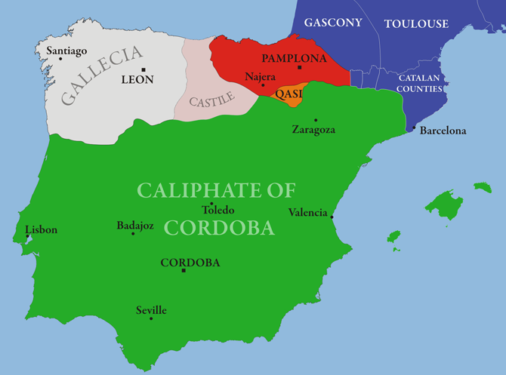
Invasion of the Iberian Peninsula
Islam spread throughout Spain
Arabic became the primary language
This was the farthest into Europe that Islam rule spread
Despite the huge amount of knowledge and emphasis on the preservation of knowledge, including science and technology, Muslims were still viewed as uncivilized and barbaric
Connection to AP World Theme #2, Development and Interaction of Cultures, especially science and technology and religions.

Slide 9
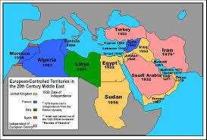
European Colonialism of Middle East
Ottoman Empire Breaks up in 1918
Middle East Split into protectorates of France and United Kingdom
Sykes-Picot Agreement

Slide 10
Different Ethnicities and Cultures
Diverse Middle East
Shiite and Sunni Muslims
Many different ethnicities (Kurds, Assyrians,Turkmens, Persians, etc)
Borders and governments made without these factors

Slide 11
Decline of Colonialism
World Wars 1 and 2 drive most major colonial powers bankrupt
Many countries gain independence, but have major internal problems due to cultural/religious differences
Leads to modern divided and turbulent Muslim world

Slide 12
Modern Terrorism: 9/11 Attacks
Happened on September 11, 2001
3,000 people killed
4 attacks (2 at World Trade Center, 1 at Pentagon, 1 plane crash in Pennsylvania)
Iraqi terrorist group Al Qaeda responsible
Osama Bin Laden and Khalid Sheikh Mohammed masterminds
Notes:
http://www.history.com/topics/9-11-attacks

Slide 13
Modern Terrorism: ISIS/ISIL
Successor to Al Qaeda
Stands for Islamic State of Syria and Islamic State of the Levant (Jordan, Israel,Palestine,Lebanon,Cyprus, and Turkey)
Claims religious authority over all muslims
Led by Abu Bakr-al-Baghdadi
ISIS has claimed responsibility for the death of 2 american journalists
Notes:
http://www.cnn.com/2014/08/08/world/isis-fast-facts/

Slide 14
Terrorism: Connection to AP themes
Accelerating global changes and realignment 1900-present
Theme #2, development and interaction of cultures, specifically religions and belief systems
The terrorists of ISIS and Al Qaeda are radical muslims who did what they did in the name of Allah (God) and thought they were going to heaven by doing it

Slide 15
...In Conclusion
Interactions between the Middle East and the rest of the world are often overlooked however they have shaped today’s societies. Between each time periods different events happened and each one connects and leads to the next.

Slide 16
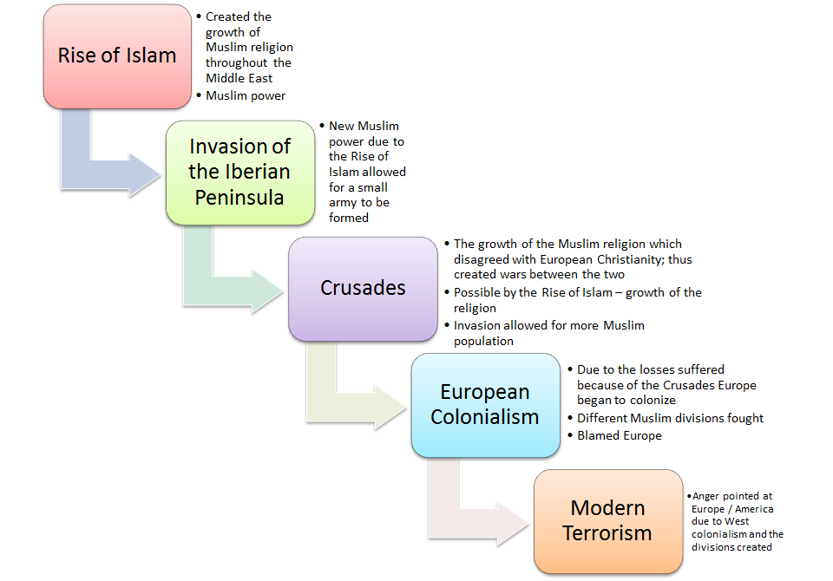

Slide 17
Bibliography
9/11 Attacks." History.com. A&E Television Networks, n.d. Web. 14 Sept. 2014.
Butler, John. "The Flow of History." FC67: The Crusades & Their Impact (1095-1291) -. N.p., n.d. Web. 14 Sept. 2014.
ISIS Fast Facts." CNN. Cable News Network, 13 Sept. 2014. Web. 13 Sept. 2014.
"Islam and the West." PBS. PBS, n.d. Web. 14 Sept. 2014.
"Middle Eastern Culture." Middle Eastern Culture. Berich LLC, n.d. Web. 14 Sept. 2014.
Nayeri, Kamran. "Our Place in the World." : 238. From Nasser to Mubarak: Part 2. Imperialism and the Arab Revolution. N.p., n.d. Web. 14 Sept. 2014.
Parenti, Michael. "Imperialism 101." Imperialism 101. N.p., 2005. Web. 14 Sept. 2014.
"Timeline of Islam." PBS. PBS, n.d. Web. 14 Sept. 2014.

