Slide 1
TRANS-SAHARAN TRADE
By: Kate Callahan, Kyle Benjamin, Clark Ellicott, Logan Roddy, and Theo Sheehan

Slide 2
Location
Spanned Northern Africa.
Sahara desert
AP Theme 1- Interaction between humans and the environment.
The desert made mass trade hard, but once people were able to use the camel, they could easily cross and the Sahara and trade with each other

Slide 3
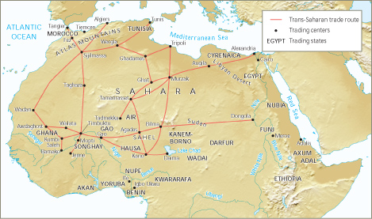

Slide 4
Regions Involved
Trade in three Regions
North Africa/Mediterranean:
Islamic Emirates
Sahara
Berber Nomads
Sudan
Trade States of Mali, Songhai
Connects to AP World theme #4: Creation, expansion, and interaction of economic systems because the different economic systems of these regions all interact over Saharan trade where they exchange goods, technology, and religion

Slide 5
Resources Traded
AP World Theme #4
Gold
Salt
Ivory
Most resources were raw materials that were traded for more manufactured goods from the Mediterranean and Islamic Worlds
Creation, expansion, and interaction of economic systems. Trade and commerce is the subsection of AP World theme #4 focused on here. This theme applies as the focus is trade here, which is caused by one people needing the resources another people have. The Sudanese states needed the manufactured goods of Europe and Asia to have efficient governments and economics, while the Europeans and Asians needed the raw materials from Africa to create their manufactured goods

Slide 6
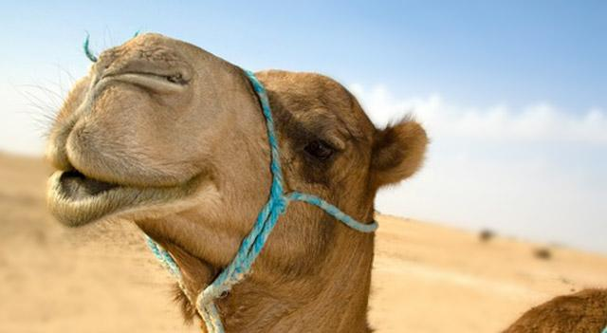
The Time Period
The Trans-Saharan Trade Network was active from the 7th to the 14th centuries.
It takes place from post classical period to early modern. The periodization is focused on regions rather than countries.
The Time Period shows AP World Themes #2 and #4, which are development and interaction of cultures and creation, expansion, and interaction of economic systems. The trade network shows these because cultures like Africa and Islam were interacting and the economic system of Africa was further developed.

Slide 7
Reasons for Trade
Africa has raw goods and needs manufactured
Europe wants Africa’s abundant gold
Islamic converts join trade to gain wealth
Kingdom of Ghana wanted to keep a core of pure metal and use gold for marketing
The reasons for trade relate to AP theme number 2, the development and interaction of cultures, because these countries and regions interacted through trade in order to meet and supply their needs. Additionally, through this trade these cultures shared ideas, technology, and religion.

Slide 8
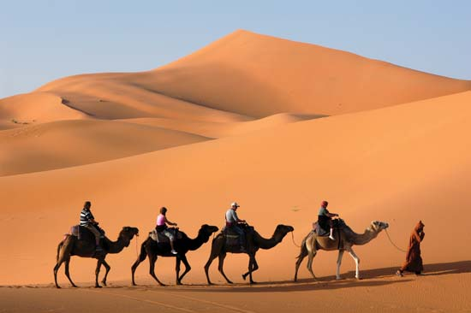
How Trade Was Facilitated
Goods were carried on caravans
Merchants traveled from oasis to oasis
Camels helped goods get transferred quicker and could survive up to 10 days without food or water
Trade was was passed between multiple groups of desert-dwellers before it reached its final destination
This relates to AP theme number one, Interaction between humans and environment, because traders were forced to adapt to the hot, dry climate and the animals they worked with while on expeditions.

Slide 9
Historiographical Perspective
Janet Abu-lughod explains her views on the world in her book: Before European Hegemony. Although it doesn’t have a specific chapter on Trans-Saharan trade, her idea is that China and other non-European cultures could have become world powers instead of the European countries if their trade and economic systems hadn’t collapsed. According to Abu-lughod, this collapse is due mainly to the many trade routes that connected with China. Had there been less, China would have been able to regulate them so that they could be a greater benefit. Although Abu-lughod doesn’t mention Trans-Saharan Trade with this idea, the amount of raw resources coming from Africa into the middle East and then China due to this trade network caused trade to be skewed in favor of the west, and caused inflation within China. This lead to the eventual economic collapse which allowed for Europeans to gain hegemony over the world instead of China or Islamic empires.

Slide 10
Analysis/Importance
The Trans Saharan trade network spread Islam throughout northern Africa and influenced the cultures of the Saharan region. Islam began in the Middle East and North Western Africa, and it spread as trade began to expand. Islam promoted global trade, and merchants and societies which adopted the Islamic faith did better in the markets. With this, many merchants and empires were forced to convert to do better economically. This changed each state's social structure and laws and also introduced Islamic cultural influences and influenced both art and architecture of each region it reached.

